Slide 1
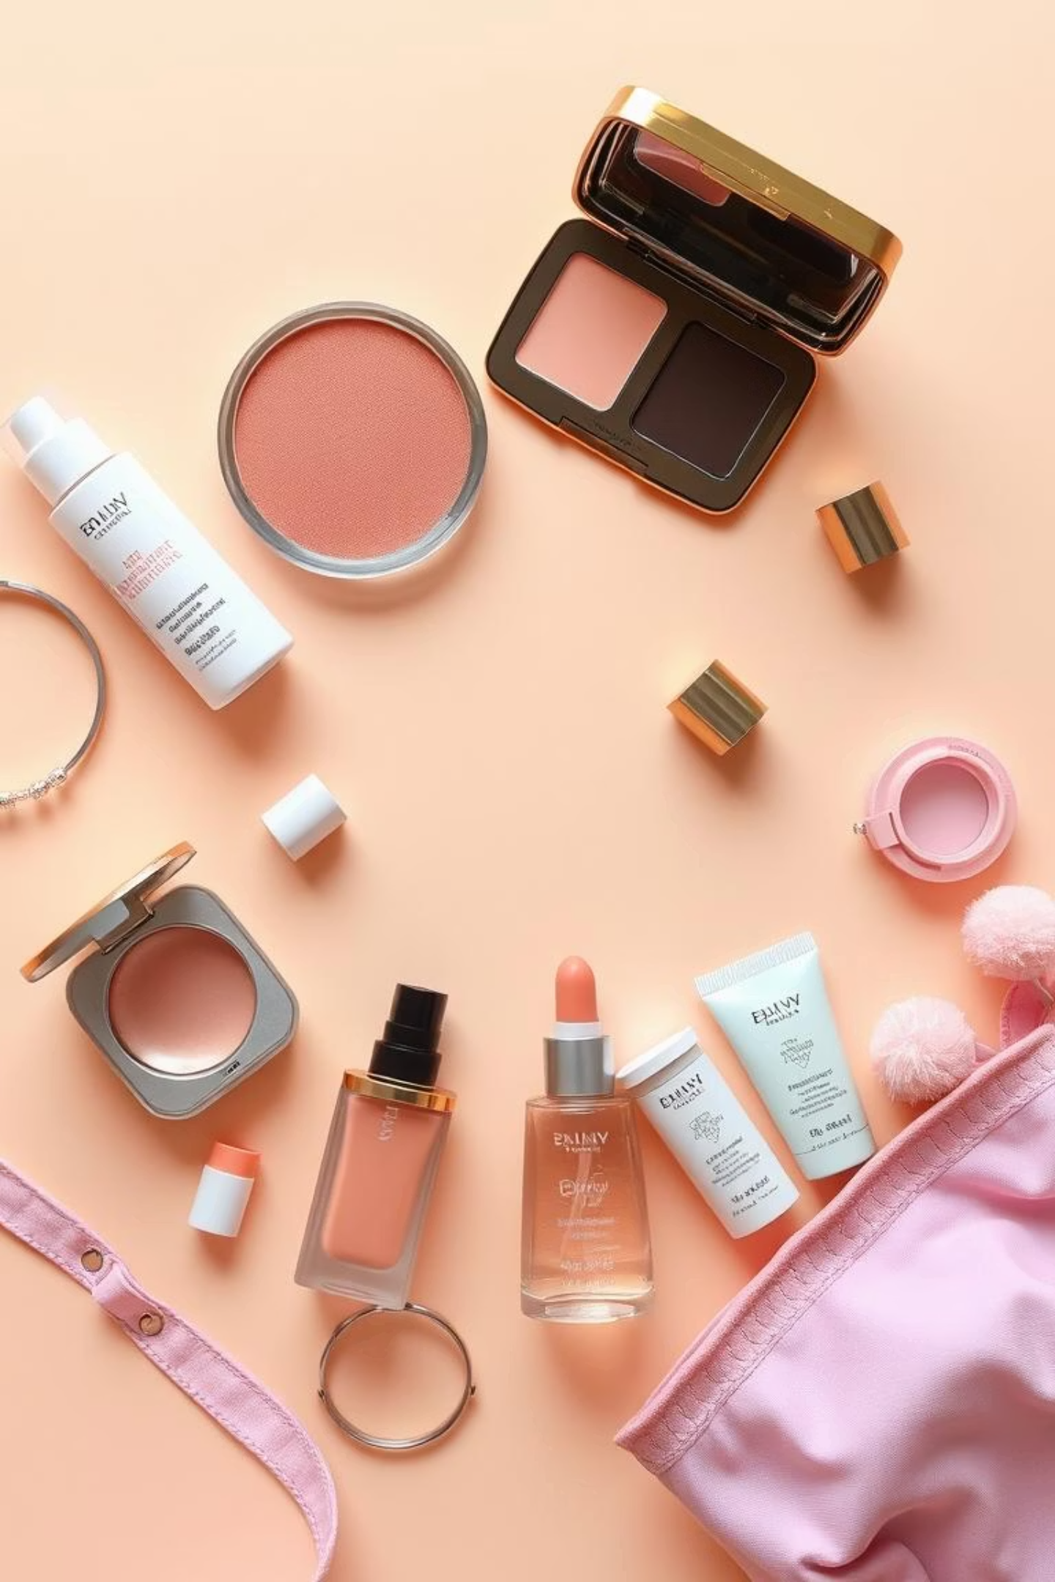
Nykaa Analysis
A Strategic Review of Customer Perception, Market Trends & Competitive Positioning
Submitted by: Dhruv
Date: July 2025

Slide 2







Introduction To Nykaa
2012
2018
2021
Founded by Falguni Nayar in Mumbai
Expanded into Fashion & Offline Stores
Successful IPO on NSE/BSE
2015
2020
2022-25
Launched mobile app & digital content
Unicorn Status; Launched Nykaa Man
40M+ customers, 230+ stores
Vision:
"Bring inspiration and joy to people, everywhere, everyday."
Mission:
"To create a world where our consumers have access to a finely curated, authentic assortment of products and services that delight
and elevate the human spirit."

Slide 3






Key Facts At A Glance
Omnichannel Business Model
Vast Product Portfolio
App, website, 230+ stores across 79 cities
2,500+ brands, 500,000+ SKUs in beauty, fashion, wellness
Strong In-House Brands
Robust Financials
Nykaa Cosmetics, Kay Beauty, Dot & Key, Nykd, 20 Dresses
FY25 Revenue: ₹2,062 Cr (↑24% YoY)
Unique Selling Proposition
Engaged Community
100% authentic, curated content, influencer-led discovery
Nykaa TV, Nykaa Network, 40M+ loyal customers

Slide 4
Business Model
Nykaa employs a powerful hybrid business model that combines the control of an inventory-led approach with the scalability
of a marketplace. This unique synergy ensures product authenticity, broad selection, and seamless customer experience.
Inventory Model
Marketplace Model
2
3
4
1
Direct brand sourcing ensures quality and authenticity.
Third-party sellers expand range, reduce inventory costs.
Omnichannel Strategy
Private Labels
Seamless online and offline shopping experience.
High-margin, exclusive in-house brands.

Slide 5





Market Position & Growth
#1 Beauty Platform
Global Brand Gateway
~30% share in Indian online beauty retail.
Trusted partner for international launches
(NARS, YSL, Chanel).
Public & Profitable
Diverse Brand Portfolio
₹57,400 Cr market cap (July 2025).
8,600+ brands including in-house hits.
Trailblazer & Omni-channel Leader
Expanding Customer Base & Competitive Edge
First Indian unicorn led by a woman (Falguni Nayar).
237 stores, 79 cities, strong app/web.
42M+ customers, ↑28% YoY.
Outperforming Amazon, Flipkart, and AJIO.

Slide 6
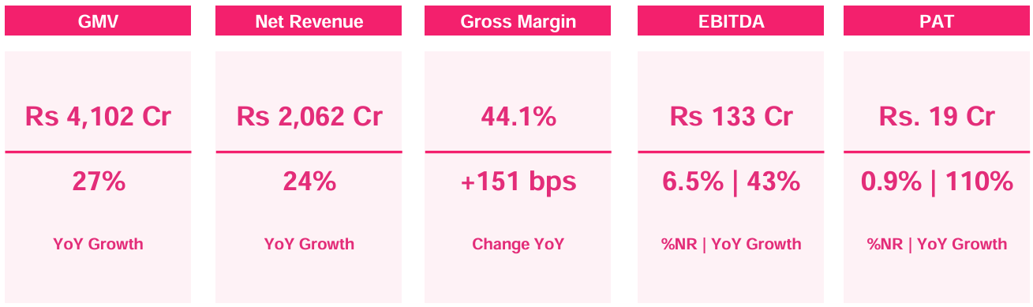
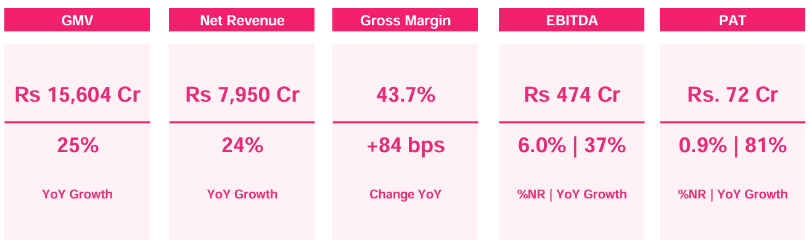
Market Position & Growth
Q4 FY2025 Performance Snapshot
FY2025 Performance Snapshot

Slide 7
Market Position & Growth
Business Highlights
₹7,950 Cr
↑ 110% YoY
92% of Revenue
↑18% Q4 GMV
Revenue Growth
Profitability Boost
Beauty Vertical Dominance
Fashion Recovery
Total revenue for FY25, reflecting
strong double-digit growth
Net profit rose 110% YoY in Q4,
backed by margin improvement
Beauty contributed 92% of
total revenue, with 25%+ growth
from e-commerce & in-house brands
Fashion GMV grew 18% in Q4,
aided by cost controls narrowing
EBITDA losses
Strategic Initiatives
+50 stores
800+ Brands
Seamless
Profitable
Retail Expansion
Brand Launchpad
Omni-channel Excellence
Private Label Momentum
50+ new stores added in FY25,
resulting in a 45% increase in
retail space
Over 800 new brands launched
in FY25, including premium
international names
Integrated app, website, and 200+
Stores to offer seamless Shopping &
high retention
In-house brands like Kay Beauty
and Nykaa Cosmetics fueling loyalty
and profitability

Slide 8
Revenue Model
Nykaa’s total revenue from operations for FY25 was ₹7,950 crore, reflecting a 24% year-on-year growth and representing the combined income from all its business segments, including beauty, fashion, private labels, marketplace commissions, B2B wholesale, and advertising.
Multi-stream Revenue Channels
Product Sales
(Inventory-Led)
Marketplace
Commissions
B2B Wholesale
(Superstore)
Advertising
& Promotions
Direct brand purchases, sold via app/site/stores → high margin, quality control
Vendor listings + promo/advert fees → scalable without holding inventory
In-house brands (e.g., Kay Beauty) → 39% YoY growth, higher profitability
Growing vertical with ₹4,000 Cr FY24 revenue
Private Labels
Fashion Marketplace
Subscription Services
Omni-channel Sales
Bulk supply to 1.95L+ retailers → wholesale GMV up
Brands pay for banners, sponsored listings, etc.
Recurring income via exclusive access & deals
Integrated store + digital presence = maximum reach

Slide 9
Revenue Model

Slide 10
Comparable Online Stores Of Nykaa In Care Products In India
Criteria | Nykaa | Purplle | Amazon | Myntra | Tira
Product Range | 500K+ | 50K+ | Massive | Moderate | Growing
Focus | Beauty + Fashion | Beauty | General | Fashion + Beauty | Premium Beauty
Private Labels | Yes | Yes | No | No | Some
Mobile App Rating | 4.6 | 4.3 | 4.1 | 4.2 | 4.4
Brand Experience | Strong | Moderate | Weak | Strong | Premium
Influencer Content | Strong | Moderate | Weak | Some | Moderate

Slide 11
Technology Utilization
Area | Technology Utilized
Personalization | AI/ML algorithms for personalized product recommendations
Data Analytics | Real-time user behaviour tracking for targeted marketing
Mobile App | Smooth UI/UX with advanced search, filters, and AR try-ons (beauty)
Supply Chain & Fulfilment | Smart warehouse management system for fast deliveries across 90%+ PIN codes
Content Platforms | Nykaa TV, Nykaa Network — tech-enabled beauty community & tutorials
Omni-channel Integration | Unified inventory across app, web, and 230+ physical stores

Slide 12


What Nykaa Leaders Say
"Technology plays a crucial role… from demand forecasting to hyper-personalization. It’s the backbone of everything we do."
— Falguni Nayar, CEO, ET Interview (2023)
"Nykaa isn’t just a retailer — we see ourselves as a content-led, technology-first lifestyle platform."
— Anchit Nayar, CEO E-Commerce, Business Insider (2022)

Slide 13


Data Analytics & Personalization
Data-Driven Insights
Personalization in Action
Real-time behavior tracking (searches, clicks, carts)
AI-driven product recommendations
Customer segmentation by preferences & budget
Custom homepages & email offers
Identifies top products, trends, seasonality
Behavior-triggered alerts (cart abandonment)
Analyzes reviews to detect dissatisfaction
Smart filters (vegan, sulfate-free, SPF)
Tracks drop-off points in user journey to improve conversations
Offers matched to user’s spend pattern
"Our recommendation engine and analytics tools help us deliver a unique journey for each user — from search to checkout." — Nykaa Tech Team, Economic Times (2023)

Slide 14
SWOT Analysis
✅
⚠
Strengths
Weaknesses
Trusted brand, omnichannel presence (230+ stores)
Heavy reliance on beauty (~90% revenue)
Successful in-house brands (Kay Beauty)
High competition (Purplle, Tira, Amazon )
Content & influencer engagement (Nykaa TV)
High operational costs, inconsistent customer service
Consistent growth: ₹7,950 Cr in FY25 (+24% YoY)
Slower traction in fashion vertical
📈
🚨
Opportunities
Threats
Expansion in Tier-II/III cities
Aggressive competitors, demand shifts
Grow high-margin private labels
Economic slowdowns, regulatory changes
Use AI/AR for deeper personalization
Global supply chain uncertainties
International market entry potential
Data privacy/security risks

Slide 15
Customer Review Analysis - Methodology
1
2
Source Collection
Thematic Grouping
Google, Trustpilot, YouTube, App Store,
in-store feedback
Delivery, Product Quality, App Experience,
Support, In-Store
3
4
Sentiment Tagging
Impact Level
Positive, Negative, Neutral analysis
High, Medium, Low on brand loyalty & trust
5
Insight Extraction
Common issues, praise points,
business implications

Slide 16





Positive Customer Reviews
Loyal Customer Base
Product Quality
Long-term users praise genuine products & consistent brand experience.
Customers appreciate authentic products and wide variety of brands.
Fast Delivery
(Nykaa Now)
Customers appreciate timely deliveries & smooth order tracking process.
Brand Trust
App Convenience
Established reputation and reliability in beauty product delivery.
Easy browsing, product discovery, and seamless checkout experience.

Slide 17





Neutral Customer Reviews
Confusing Returns
Out-of-Stock
Delays & confusion with exchanges/returns of defective items.
Shoppers can't find favorite products, wait for restocks.
Undertrained Staff
Store employees lacking product knowledge.
App Coupon Glitches
Damaged Packaging
Coupons disappearing or being rejected without clear reasons.
Reduces premium unboxing experience.

Slide 18





Negative Customer Reviews
App Bugs During Payment
Refund Delays
Few users faced issues during payment, especially with coupons or UPI.
Several users report delayed or unresolved refund cases.
Poor Customer Support
Difficulty in reaching support or receiving scripted responses.
Wrong or Damaged Orders
Lack Of Testers In Physical Stores
Complaints about receiving incorrect or used/missing items.
Offline customers were unhappy due to missing product testers.

Slide 19
Customer Review Impact Segmentation Table
High Impact | Medium Impact | Low Impact
Refund delays affecting user trust | Coupon application confusion | Wishlist or save feature missing
Wrong or damaged products | Average in-store staff behaviour | App UI design suggestions
Delivery delays during peak sales | Out-of-stock issues for niche products | Request for more product filters
Customer service not responsive or delayed | App lags or slow checkout on select devices | In-store tester unavailability
Repeated order cancellation without notice | Mixed feedback on packaging | Minor layout changes suggested
App bugs during payment causing order failures | Delivery agent behavior feedback | Lack of regional language support

Slide 20
Nykaa & Its Competitors In July 2025
Nykaa Ecosystem Brands/Companies | Monthly Visits | Authority Score | Bounce Rate
Nykaa (nykaa.com) | 8.73M | 75 | 69.29%
Nykaa Man (nykaaman.com) | 1.65M | 43 | 72.03%
Nykaa Fashion (nykaafashion.com) | Data not separately available | — | —
Superstore by Nykaa (B2B platform) | B2B platform, not public traffic | — | —
Nykaa Cosmetics, Kay Beauty, Dot & Key, Nykd, (in-house brands) | — | — | —
Nykaa Competitors | Monthly Visits | Authority Score | Bounce Rate
Purplle | 1.63M | 57 | 75.32%
Mamaearth | 2.44M | 59 | 75.65%
Myntra | 60.67M | 84 | 64.61%
Tira Beauty | 3.2M–4.1M | — | 50.92%
Sephora India | 195.7K | — | —
Plum Goodness | 741K–508K | — | —
BeMinimalist | 2M | — | —

Slide 21
Competitive Analysis – Nykaa VS Industry Players
Key Competitors
Direct: Purplle, Tira, Sephora India
Adjacent/D2C: Mamaearth, Plum, BeMinimalist
Category Giant: Myntra (Fashion + Beauty Hybrid)
Factor | Nykaa | Key Competitors
Monthly Traffic | 8.73M | Myntra (60M+), Tira (3–4M), Mamaearth (2.4M), Purplle (1.6M)
Authority Score | 75 (very strong SEO) | Myntra (84), Mamaearth (59), Purplle (57)
Bounce Rate | 69.29% | Tira (50.9%), Purplle (75%), Mamaearth (75.6%)
Brand Ecosystem | Robust (Fashion, B2B, Men) | Most offer 1–2 verticals only
Physical Stores | 230+ | Tira (~50), Sephora (~30), others online-only
Content Strategy | Nykaa TV, influencers | Minimal or generic across most rivals
Omnichannel | Yes (App + Web + Retail) | Mainly digital; few have offline presence

Slide 22
Strategic Recommendations for Nykaa
Delivery & Refunds
Customer Support
Product Authenticity
Partner reliable couriers,
streamline refund timelines.
Train agents, launch live ticket tracking.
Introduce AI checks, verified packaging indicators.
In-Store Staff
App & UX Enhancement
Reduce Bounce Rate
Standardize training, collect
instant feedback.
Fix bugs, add smart filters, gamify loyalty.
Utilize personalization and AR
tools to boost engagement.
Monitor Competition
Track Tira, Purplle; expand faster in Tier-2 markets.

Slide 23
Websites Used For Analysis
https://www.nykaa.com/
https://economictimes.indiatimes.com/industry/services/retail/nykaa-makes-biggest-physical-expansion-in-retail-space-in-fy25-adds-50-new-stores/articleshow/121517595.cms
https://www.semrush.com/website/nykaa.com/competitors/
https://www.pocketful.in/blog/nykaa-case-study-swot-analysis-and-marketing-strategy/
https://rankexdigital.com/swot-analysis-of-nykaa/
https://www.linkedin.com/posts/rashmi-s-2a8aa6216_how-nykaa-used-data-analytics-to-become-a-activity-7299437460336316416--6LG/-
https://aws.amazon.com/solutions/case-studies/nykaa/
https://www.nykaa.com/media/wysiwyg/uiTools/2025-5/Investor-Presentation-Q4-and-FY25.pdf
https://www.goodreturns.in/news/nykaa-q4-results-2025-updates-fsn-e-commerces-net-profit-surges-193-yoy-to-rs-20-28-crore-revenue-up-1432807.html
https://shyamfuture.com/details-on-nykaas-business-model-know-how-it-makes-money/
https://www.youtube.com/

